Slide 1
Workshop: Data Modelling of Persons and Organisations
MS Teams (120min)
17 september 2021
#beinterop
start at 13:00

Slide 2
Agreements
Audience is muted and webcam is turned off.
Questions, comments or suggestions can be shared via the chat function of MS Teams.
→ Interaction is encouraged!
+1 of -1
A yes/no question can be answered simply and quickly via chat:
Agree= +1 Disagree= -1

Slide 3
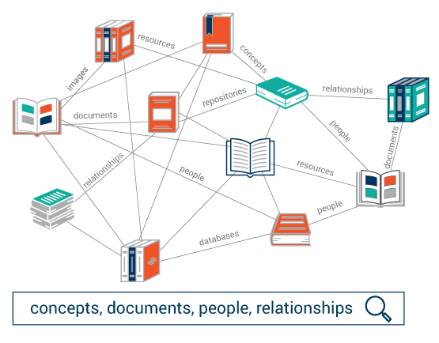
Today
13:05 - 13:50 - plenary​
Introduction ICEG 10’​
About linked data 40'

Slide 4
Today
13:05 - 13:50 - plenary​
Introduction ICEG 10’​
About linked data 40'
13:50 – 14:00
Break 10'

Slide 5
Today
Creative Work
+about
+abstract
+audience
+date created
+identifier
+URL
13:05 - 13:50 - plenary​
Introduction ICEG 10’​
About linked data 40'
13:50 – 14:00
Break 10'
14:00-14:45 – break-out
Case Person and Organisation 45'
Author
+name
+surname
Library
+address
+name
Publisher
+name

Slide 6
Today
13:05 - 13:50 - plenary​
Introduction ICEG 10’​
About linked data 40'
13:50 – 14:00
Break 10'
14:00-14:45 – break-out
Case Person and Organisation 45'
14:45 – 15:00 - plenary
Wrap-up and questions 15'

Slide 7
13:05 - 13:10 - Introduction
Introduction

Slide 8
ICEG mission statement and roles
The ICEG* review group ‘open standards’ has a permanent character and is responsible for the central coordination and follow-up of the work related to the standardisation of information.
Mission aligned to the existing ICEG collaboration agreement between the federal, regional and community authorities (dd. 2013-08-26).
The work is part of the standardisation of:
•meaning of the information (semantic),
•syntax (grammar) and technical standards for the exchange of the information
•metadata for discoverability ('data on data’).
In addition, the working group monitors
•mutual consistency of standards,
•international standards that impact governments in Belgium
•generic development and the change process.
The working group on data standards gathers on a regular basis.
(*) ICEG = Interfederal Collaboration on e-Government
Notes:
Bart

Slide 9
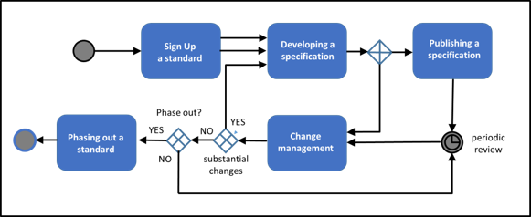
Governance: ICEG process and method
Scalable process for registering, developing, changing and phasing out data standards.
Abstract: French, Dutch
Full paper: English
W3C, IEEE, IETF, IAB en ISA, Open Stand, OSLO​

Slide 10
13:10 - 13:50 - About linked data
Levels of interoperability
Governance
Semantic data
API’s
Tooling

Slide 11
Interoperability
The ability of different autonomous organizations or systems to communicate and collaborate with each other.
Notes:
Bart

Slide 12
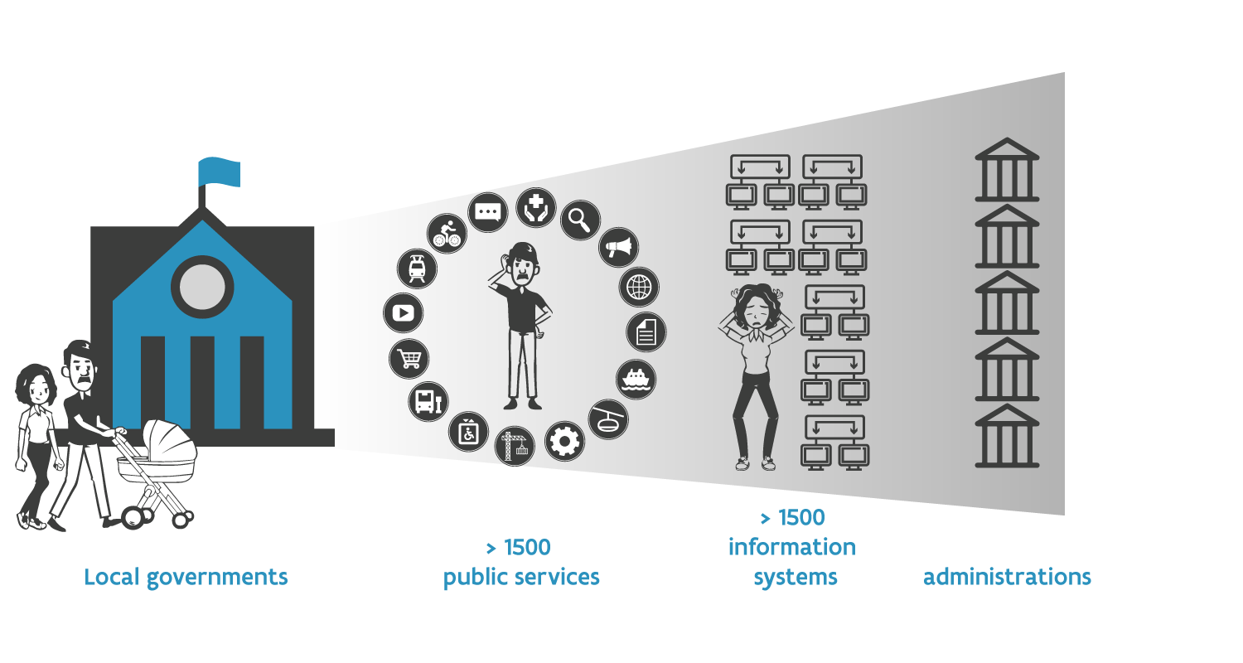
Interoperability: Why important?
> 1000 public services
> 250 information systems
> 1500 public administrations
Local government
Notes:
Bart

Slide 13
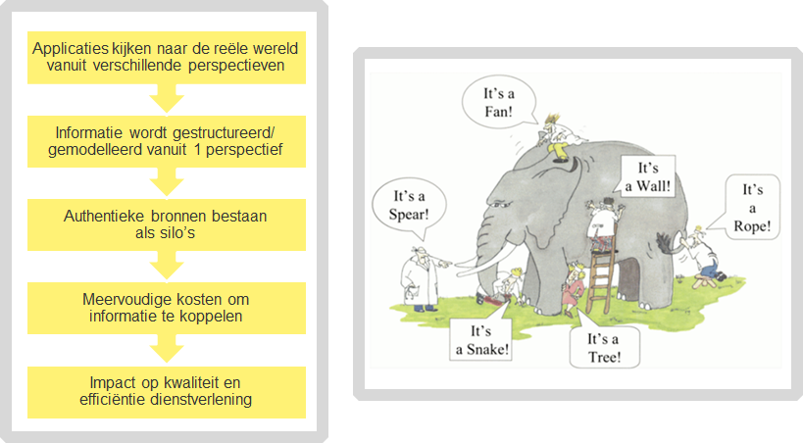
Semantic interoperability
Applications look at the real world from different perspectives
Information is structured/ modeled from 1 perspective
Authentic sources exist as silos
Multiple costs to linked information
Impact on quality and efficiency of service

Slide 14
4 levels of interoperability
refers to inline legislation between different organizations and policy areas
Legal interoperability
Organisational interoperability
aligning business processes between different organisations and policy areas
focuses on the meaning of data elements
Semantic interoperability
Technical interoperability
pertains to the different protocols, formats and interfaces

Slide 15
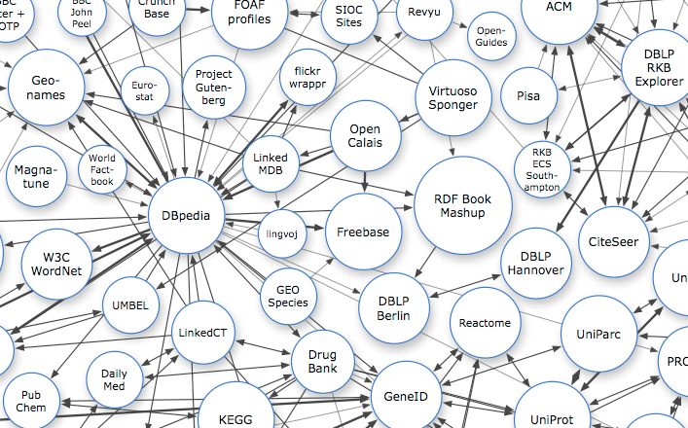
Technical interoperability: The web as a blueprint
Persistent Identifiers: URIs
Dereferencable HTTP URIs
Standardised Information (RDF)
Links to other information
Notes:
Sven
Uniform Resource Identifiers (URIs) should be used to name and identify individual things.
HTTP URIs should be used to allow these things to be looked up, interpreted, and subsequently "dereferenced".
Useful information about what a name identifies should be provided through open standards such as RDF, SPARQL, etc.
When publishing data on the Web, other things should be referred to using their HTTP URI-based names.

Slide 16
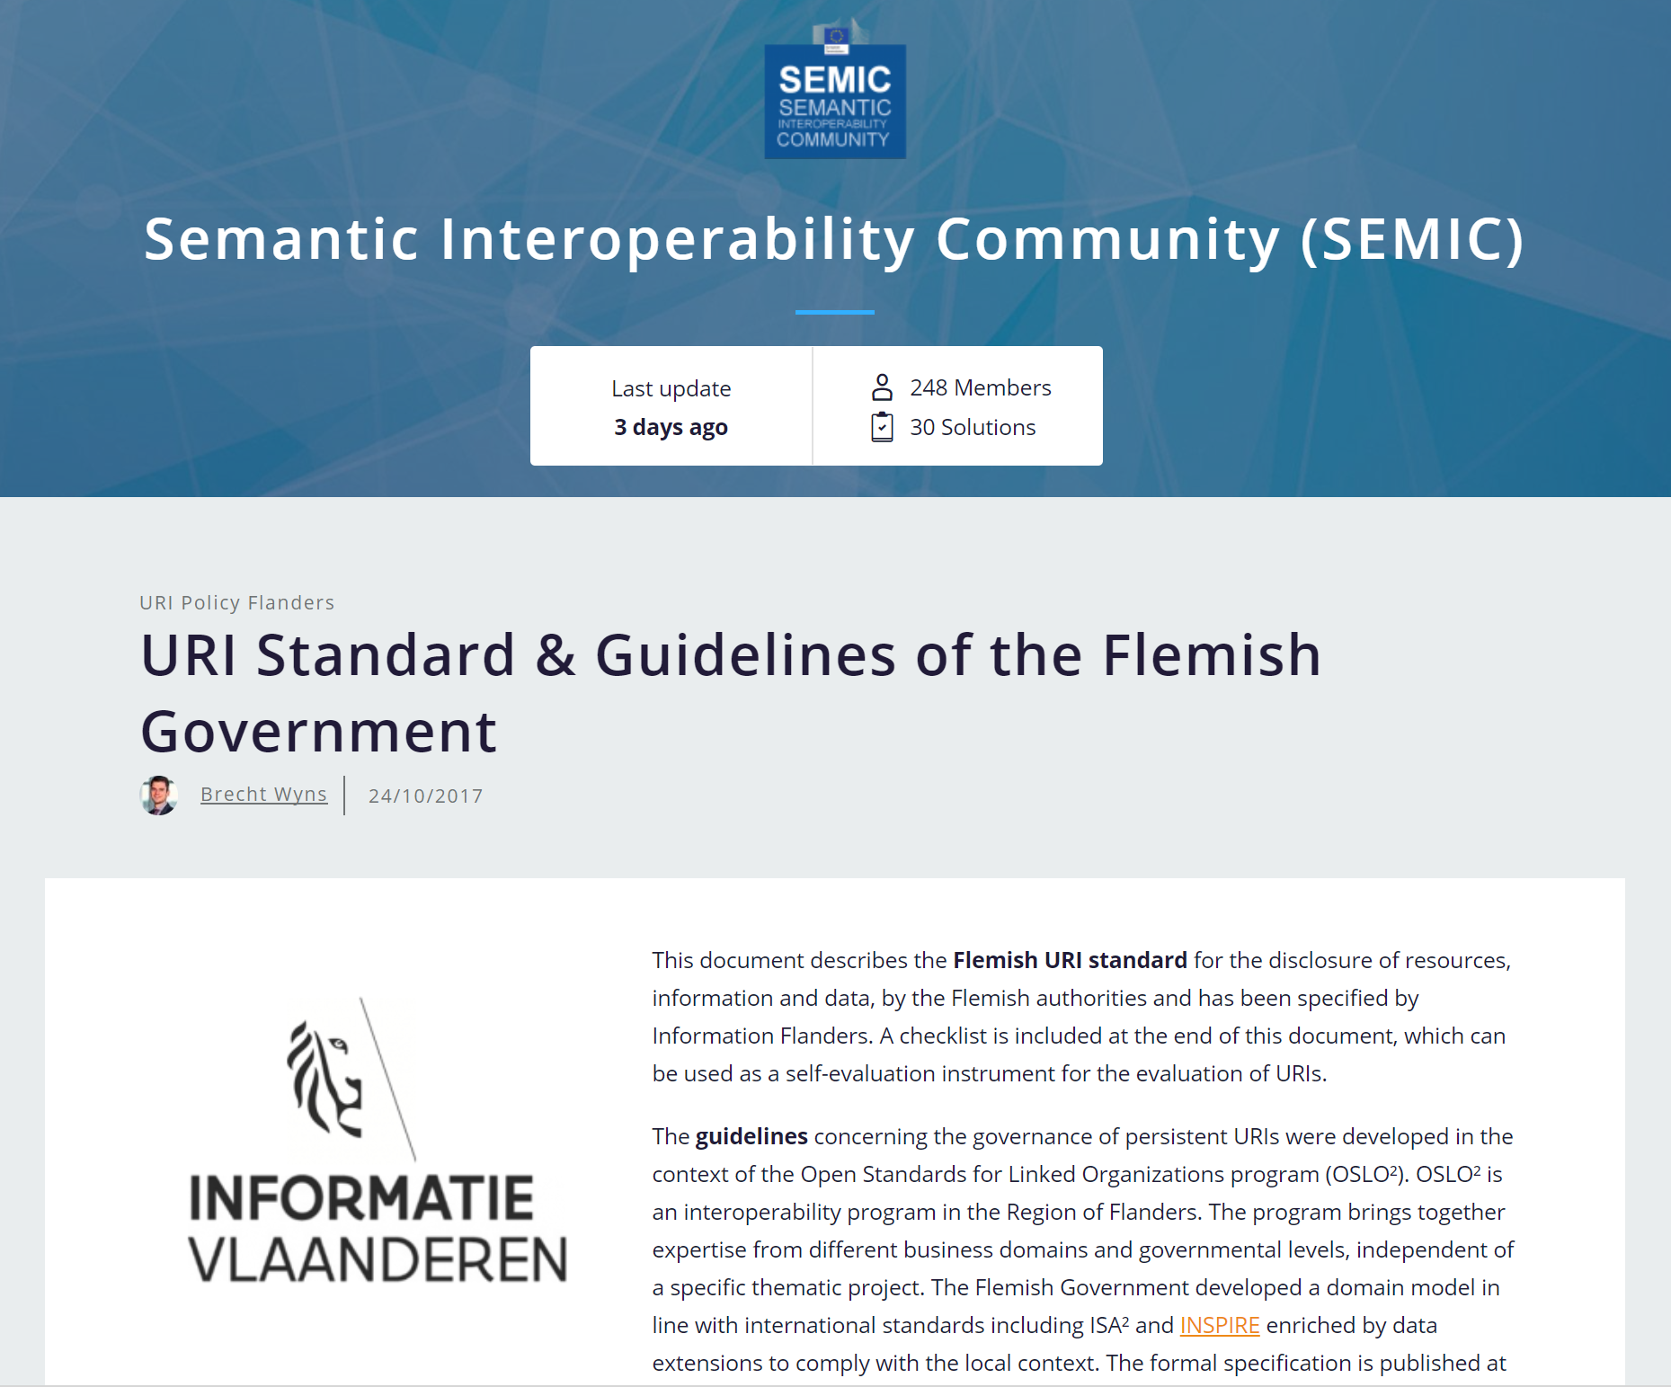
Technical interoperability: The web as a blueprint
Persistent Identifiers: URIs
http://data.vlaanderen.be/id/adres/3706808
Koningin Maria Hendrikaplein 70,
9000 Gent
Dereferencable HTTP URIs
Standardised Information (RDF)
Links to other information
Notes:
Sven

Slide 17
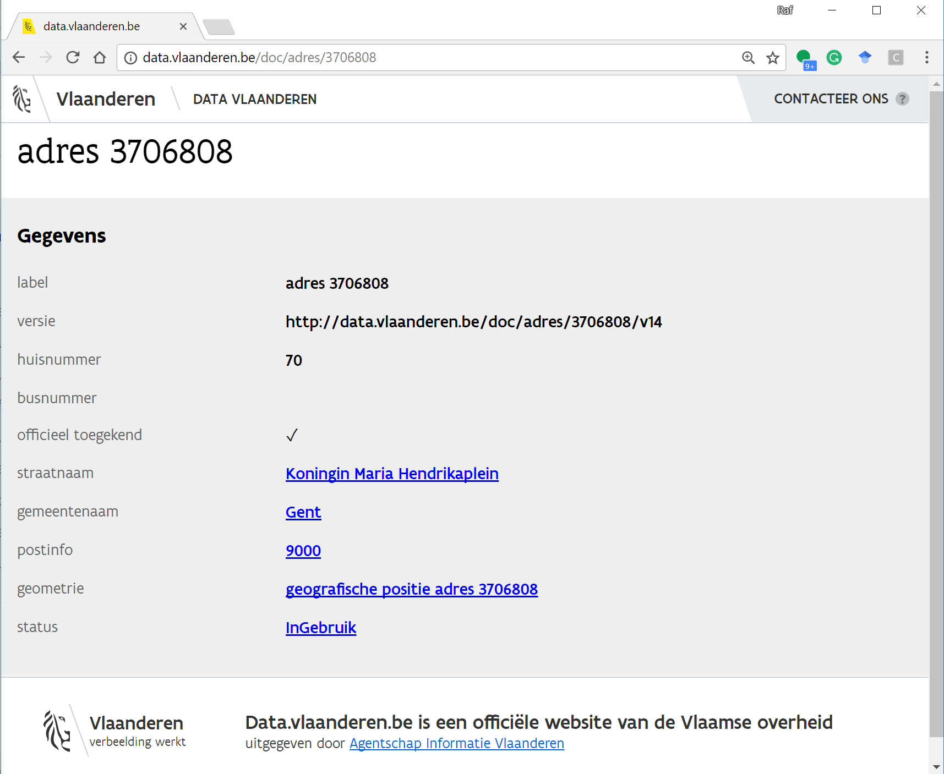
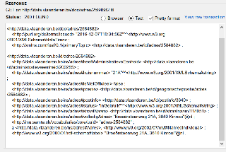
Technical interoperability: The web as a blueprint
Persistent Identifiers: URIs
Dereferencable HTTP URIs
http://data.vlaanderen.be/id/adres/3706808
Gestandaardiseerde Informatie (RDF)
Links naar andere informatie
Human readable
Computer readable
Notes:
Sven

Slide 18
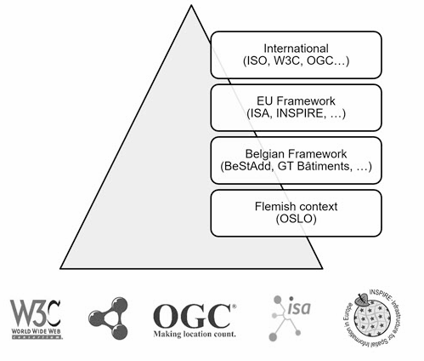
Technical interoperability: The web as a blueprint
Persistent Identifiers: URIs
Dereferencable HTTP URIs
Standardised Information (RDF)
http://data.vlaanderen.be/ns/adres
https://www.w3.org/ns/locn#adminUnitL2
Links to other information
Notes:
Sven

Slide 19
Technical interoperability: The web as a blueprint
Persistent Identifiers: URIs
Dereferencable HTTP URIs
Standardised Information (RDF)
Links to other information
data.vlaanderen.be/id/organisatie/OVO002949
Agentschap Informatie Vlaanderen
http://data.vlaanderen.be/id/adres/3706808
Koningin Maria Hendrikaplein 70
9000 Gent
Notes:
Sven

Slide 20
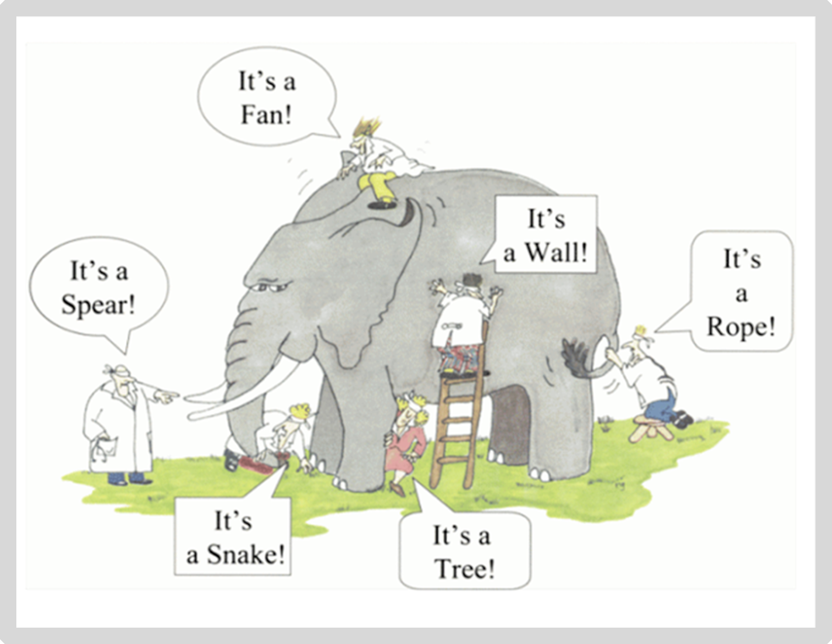
It’s all about the context
Notes:
Florian
The context and the perspective we take to look at things influence the way we name, describe and use it.
Data models have always certain purposes putting their creators in a certain context. It is normal, we simply need to be aware of it.

Slide 21
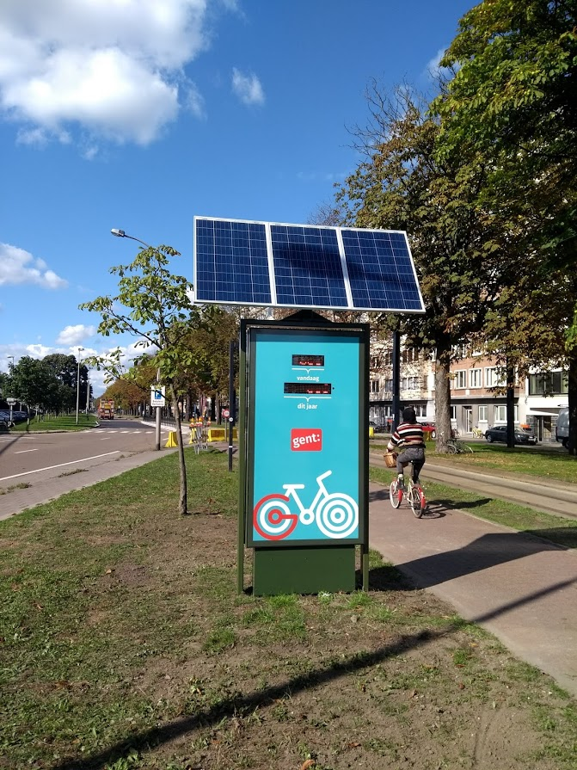
But how do we understand each other?
JSON
{
“Fietsteller-Zuid” : {
“type” : “BicycleCounter”,
“city” : “Ghent”,
“today” : “100”
}
}
Table / CSV / Spreadsheet
name | type | location | number
F7 Gent-Kortrijk | BikePassageCounter | Waregem | 250
Notes:
Florian
The same information can be structured in different ways or formats, we describe those with the term serialisations.
but can also very often mean different things. As humans, we tend to use a lot textual descriptions as unstructured data. A common human-readable structured data format is tables like here.
In the example, we want to describe a bike counter: its name, location, what it represents exactly (or in other words its type) and the number of bikes it has counted.
When comparing the two data extracts here, you can quickly see that the location becomes the city and the number is replaced by an indication of time “today”. The result is: the data captured in the two cases may not represent exactly the same reality.

Slide 22
I want to exchange data
JSON
{
“Fietsteller-Zuid” : {
“type” : “BicycleCounter”,
“city” : “Ghent”,
“today” : “100”
}
}
Notes:
Florian
As humans, we can quickly make assumptions and comparisons. But what if we want to exchange data between machines?

Slide 23
We know, but machines don’t
Triples!
<Fietsteller-Zuid> <type> <BicycleCounter>
<Fietsteller-F7> <type> <BikePassageCounter>
<Fietsteller-Zuid> <today> <100>
<Fietsteller-F7> <number> <250>
→ BicycleCounter is the same as a BikePassageCounter
→ Number basically means the same as today in this context
Notes:
Florian
We know, but machines don’t.
Machines need clear instructions to process information. Therefore, the concept of triples was introduced.
A triple describes the fact that something has a relation to something else or subject-predicate-object. Each data subject, for example Fietsteller Zuid or F7, is related to specific data objects, such as “BicycleCounter” through a predicate describing what the machine could expect from the object. Nonetheless, we still have our issue of data meaning different things. If various organisations create and maintain the data, we can expect the data to have slightly different meanings.

Slide 24
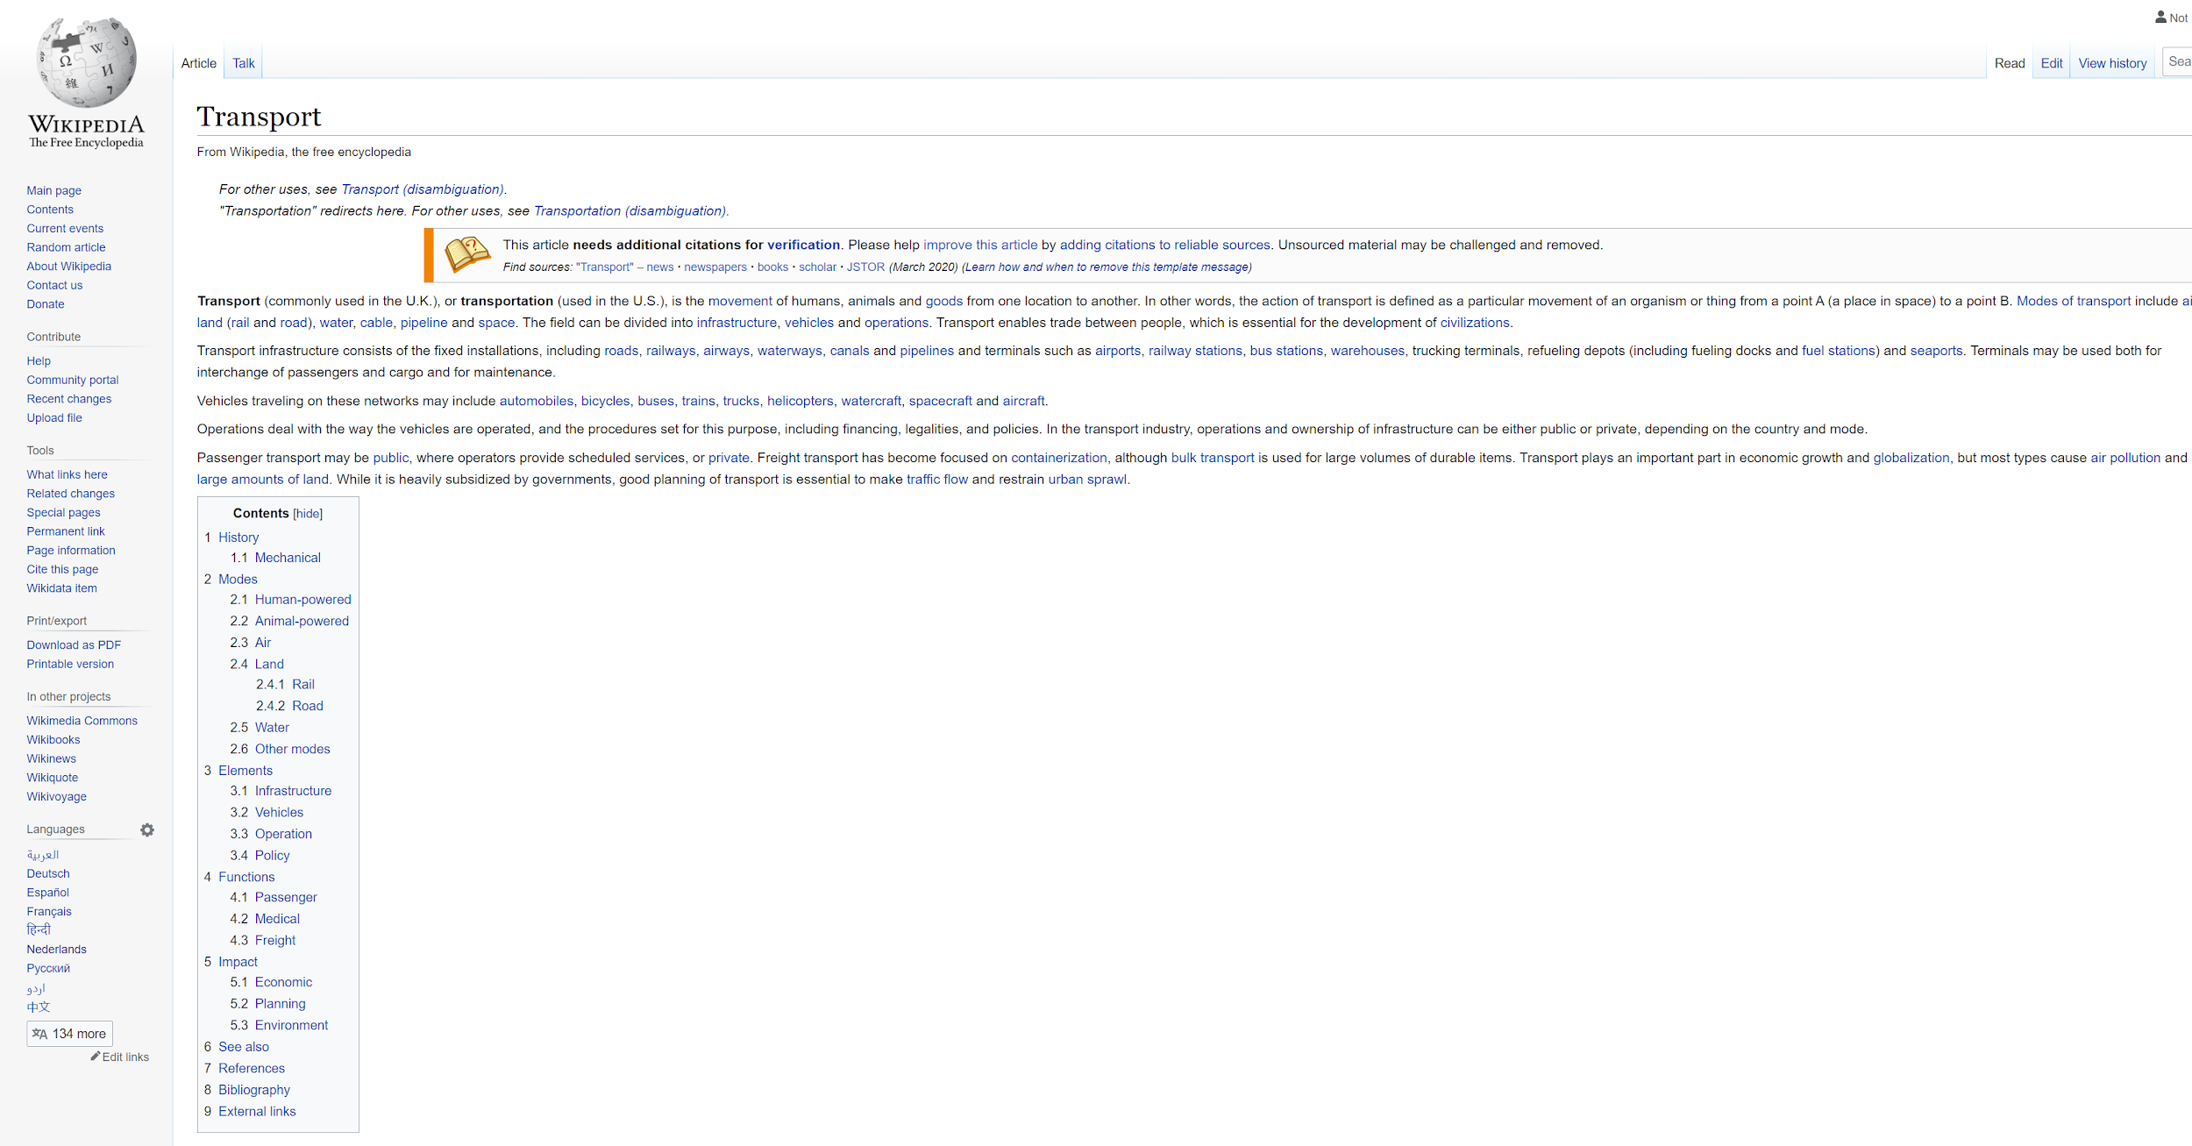
Solved by using URIs
<Fietsteller-Zuid> <type> <BicycleCounter>
<Fietsteller-F7> <type> <BikePassageCounter>
<Fietsteller-Zuid> <today> <100>
<Fietsteller-F7> <number> <250>
<Fietsteller-Zuid> <type> <BicycleCounter>
<Fietsteller-F7> <type> <BikePassageCounter>
<Fietsteller-Zuid> <today> <100>
<Fietsteller-F7> <number> <250>
https://wikipedia.org/BikeCounter
But machines only get a human readable description (HTML)
URI = Uniform Resource Identifier
Notes:
Florian
Linked Data solves this issue by identifying each part of the triple uniquely. That is the concept of URI. In our example, the type “BicycleCounter” could be attributed a unique identifier by Wikipedia.
The other good aspect with URI is that they can easily be made resolvable, i.e. pointing to an HTML page.
When creating and attributing URIs, we need to make sure that both humans and machines can read and process the information.

Slide 25
We use URIs that provide both a human and machine
readable description
<Fietsteller-Zuid> <type> <BicycleCounter>
<Fietsteller-F7> <type> <BikePassageCounter>
<Fietsteller-Zuid> <today> <100>
<Fietsteller-F7> <number> <250>
https://data.vlaanderen.be/ns/example#BikeCounter
Human readable
Machine readable
Notes:
Florian

Slide 26
Applying context and URI’s to our example,
creating JSON-LD
{
“@context” : {
“BicycleCounter” : “https://data.vlaanderen.be/ns/example#BikeCounter”
“today” : “https://data.vlaanderen.be/ns/example#totalNumberOfBicycles”
},
“@id” : “https://example.org/id/Fietsteller-Zuid”,
“@type” : “BicycleCounter”,
“today” : 100
}
{
“@context” : {
“BikePassageCounter” : “https://data.vlaanderen.be/ns/example#BikeCounter”
“number” : “https://data.vlaanderen.be/ns/example#totalNumberOfBicycles”
},
“@id” : “https://example.org/id/Fietsteller-F7”,
“@type” : “BikePassageCounter”,
“number” : 250
}
Notes:
Florian

Slide 27
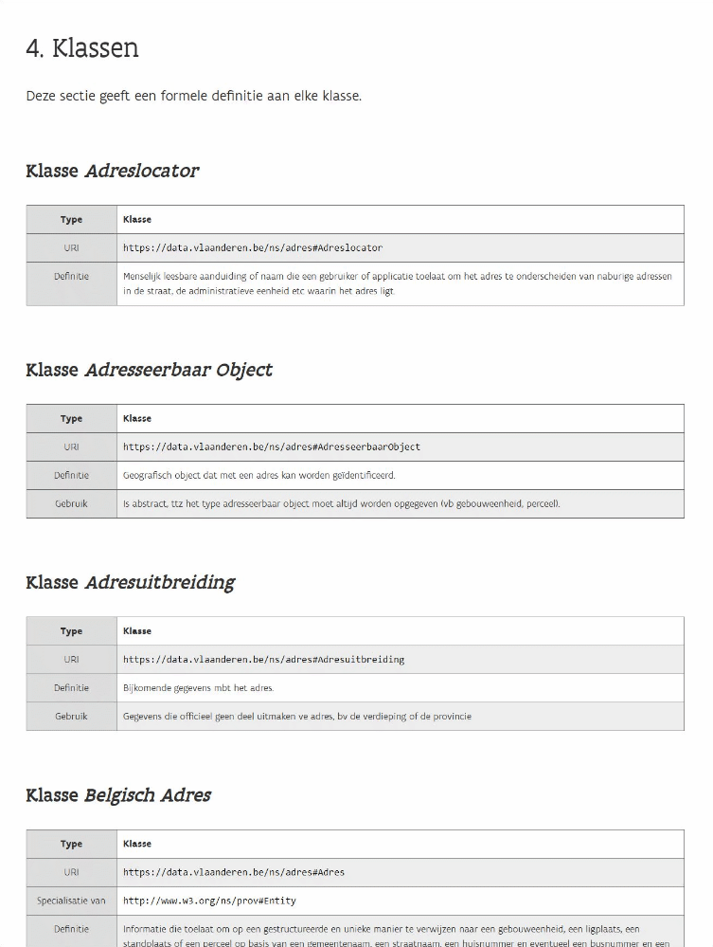
Vocabularies & Application Profiles
Vocabularies contain a list of terms
per domain
→ For example: address, organization, person, ...
Notes:
Florian

Slide 28
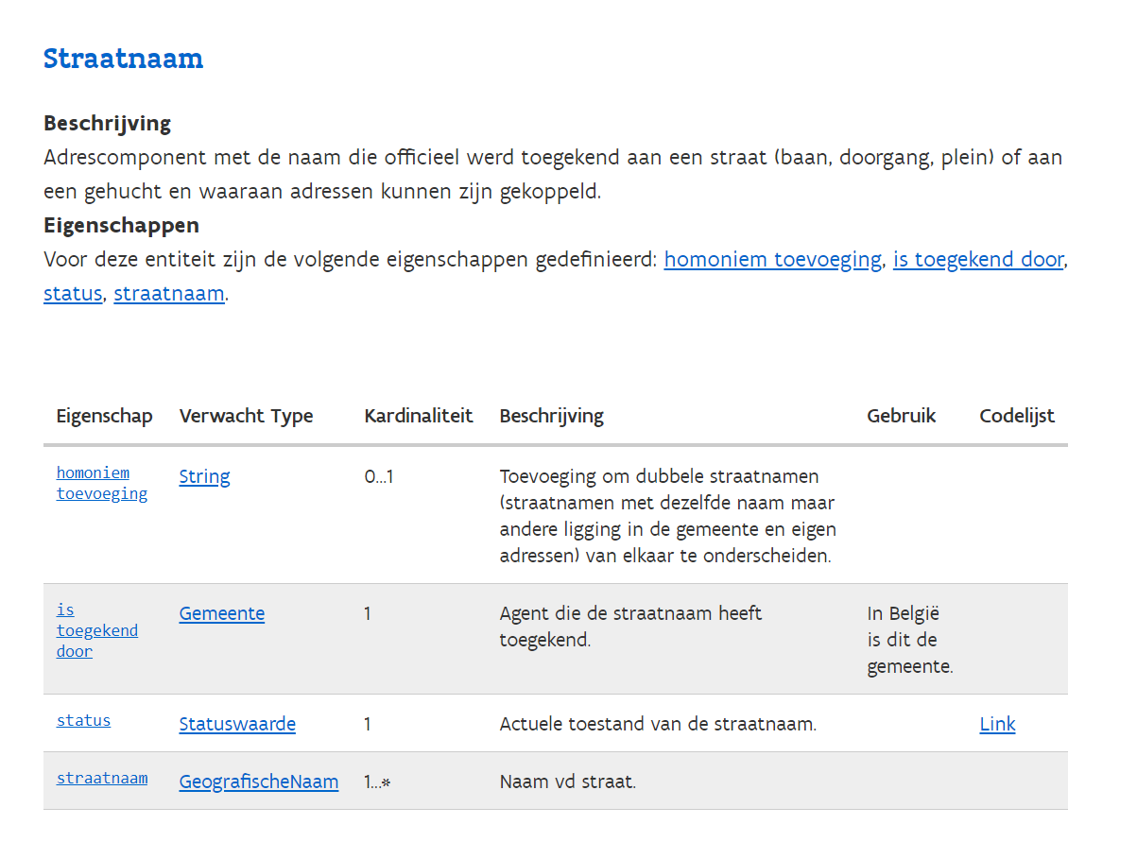
Vocabularies & Application Profiles
Application profiles determine which
data must be exchanged
→ For example: a street name
Notes:
Florian

Slide 29
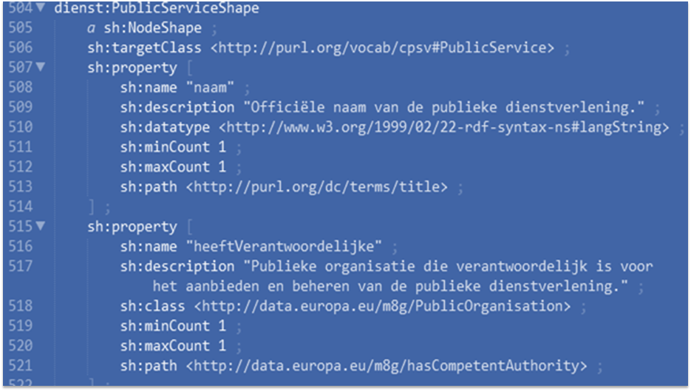
I have an API that publishes semantic data
Is my data in line with these standards? (compliance)
→ Technical contracts as SHACL* ensure this.
A document with a set of conditions
SHACL = Shapes Constraints Language
Notes:
Florian

Slide 30
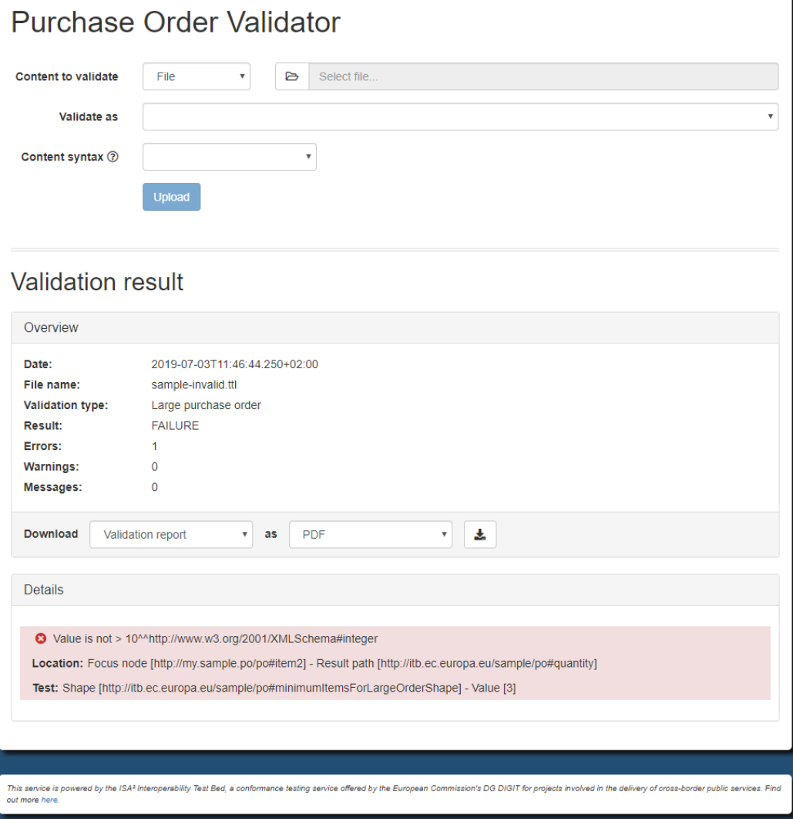
Tooling: SHACL-validator
Europe provides tools to do this automatically: RDF validator
Frontend
REST API
SOAP API
Flanders built its own frontend on top of the EU backend
Notes:
Florian

Slide 31
Instruction for exercise:
Case “Data modelling of persons and organisations”

Slide 32
Exercise
In groups (NL, FR, ENG) we will go through the exercise of making our own implementation model.
The purpose is to get familiar with building implementation models.

Slide 33
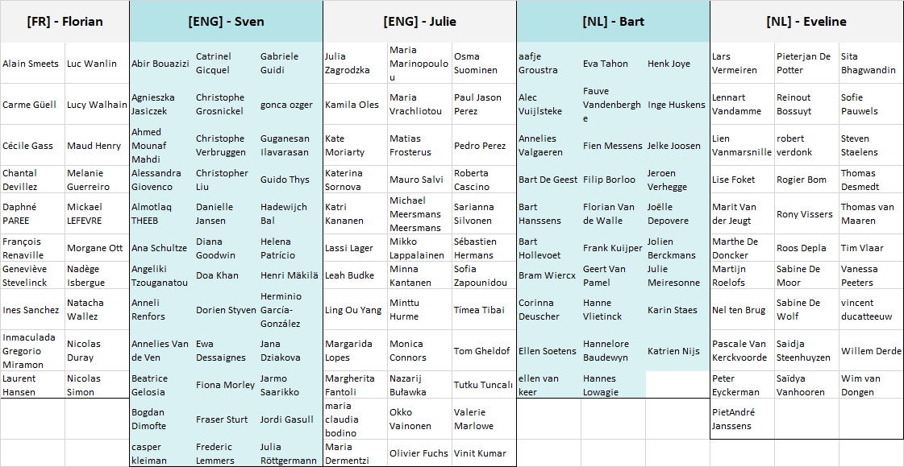

Slide 34
5 break out rooms in MS Teams
Group 1 [FR] - Florian: https://bit.ly/iceggroup1
Group 2 [ENG] - Sven: https://bit.ly/iceggroup2
Group 3 [ENG] - Julie: https://bit.ly/iceggroup3
Group 4 [NL] - Bart: https://bit.ly/iceggroup4
Group 5 [NL] - Eveline: https://bit.ly/iceggroup5

Slide 35
1. Define use case
2. List and inventarize relevant concepts
3. Study and look for existing vocabularies and AP’s
4. Map your concepts on the existing vocabularies and AP’s
5. Find a solution for unmapped concepts
6. Establish an implementation model

Slide 36
How to connect to Miro?
https://bit.ly/workshopkbr
Follow the link to the Miro Whiteboard.
Explore the board.
Notes:
Move nog toevoegen

Slide 38
14:00 - 14:45 – Case “Data modelling of persons and organisations”
Illustration of the case
5 break-out rooms

Slide 39
Timeline exercise (45’)
Step 1: Define use case (5’)
Intro (5’)
facilitator explains use case
Step 2: List and inventarize concepts (10')
Intro (2')
Execute (8')
Step 3: Look for existing voc’s and AP’s (10')
Intro (2')
Execute (8')
Step 4: Map your concepts (5')
Intro (2')
Execute (3')
Step 5: Find a solution for unmapped concepts (5')
Intro (5')
Step 6: Establish an implementation model (10')
Intro (10')
Notes:
concepten uit de use case halen die ze herkennen. Moderator overloopt de verschillende concepten and clusters towards the predefined concepts in slides 47 (this is the solution)

Slide 40
1. Define use case
2. List and inventarize relevant concepts
3. Study and look for existing vocabularies and AP’s
4. Map your concepts on the existing vocabularies and AP’s
5. Find a solution for unmapped concepts
6. Establish an implementation model

Slide 41
Step 1
Step 1: Define use case
Step 2
Step 3
Step 4
Step 5
Step 6
Use case:
The exchange of information about different types of creative works available within our library. This includes information on :
The type creative work (books, movies, photographs…)
The author
The publisher of the work
…
solution

Slide 42
1. Define use case
2. List and inventarize relevant concepts
3. Study and look for existing vocabularies and AP’s
4. Map your concepts on the existing vocabularies and AP’s
5. Find a solution for unmapped concepts
6. Establish an implementation model

Slide 43
Step 1
Step 2: List and inventarize relevant concepts
Step 2
Step 3
Step 4
Step 5
Step 6
Exercise: List the information-elements needed to implement the use case.
An example
Use case: I want to build an application where the nearest toilet will be displayed.
Concepts or information-elements needed:
Location (of the user, the toilets)
..
Our use case:
The exchange of information about different types of creative works available within our library. This includes information on :
The type creative work (books, movies, photographs…)
The author
The publisher of the work
…
Concept
Location
Concept 2
Concept 3
Concept 4
Concept 5
…

Slide 44
Step 1
Step 2: List and inventarize relevant concepts
Step 2
Step 3
Step 4
Step 5
Solution
The exchange of information about different types of creative works available within our library. This includes information on :
The type creative work (books, movies, photographs…)
The author
The publisher of the work
…
Step 6
Concepts
Library
Creative Work
Author
Publisher
Location
...
solution

Slide 45
1. Define use case
2. List and inventarize relevant concepts
3. Study and look for existing vocabularies and AP’s
4. Map your concepts on the existing vocabularies and AP’s
5. Find a solution for unmapped concepts
6. Establish an implementation model

Slide 46
Step 1
Step 3: Look for existing vocabularies and AP’s
Step 2
Step 3
Step 4
Step 5
Step 6
International Standards
EU ISA CORE vocabs
OSLO Extensions

Slide 47
Step 1
Step 3: Look for existing vocabularies and AP’s
Step 2
Step 3
Step 4
Step 5
Linked Open Vocabularies: https://lov.linkeddata.es/dataset/lov
Browse to data.vlaanderen.be/ns where you can view the existing OSLO vocabularies and application profiles.
Explore the AP’s and see what you find interesting, eg: “Persoon Basis”, “Organisatie”, “Dienstencataloog”, ..
Click on the classes to jump to the vocabulary.
Write down the classes (eg. “Adres”, “Persoon”, “Organisatie”) that are relevant and reusable for this case.
Step 6

Slide 48
Step 1
Step 3: Look for existing vocabularies and AP’s
Step 2
Step 3
Step 4
In our use case, the following models might be useful for the concepts that were defined:
Step 5
Step 6
Concepts | Relevant models | Source data model
Library | Registered Organisation | OSLO Organisatie
Creative Work | ?? | ??
Author | Person | OSLO Persoon
Publisher | Registered Organisation | OSLO Organisatie
... | … | …
solution

Slide 49
1. Define use case
2. List and inventarize relevant concepts
3. Study and look for existing vocabularies and AP’s
4. Map your concepts on the existing vocabularies and AP’s
5. Find a solution for unmapped concepts
6. Establish an implementation model

Slide 50
Step 1
Step 4: Map your concepts on existing vocabularies and
AP’s
Step 2
Step 3
Step 4
Step 5
Put the necessary concepts (identified in step 2) next to the existing (OSLO) classes (step 3) to identify the differences and similarities.
Provide a mapping value (SKOS) to the overlap (see next slide):
Exact match
Related match
Broad match
Narrow match
No match
Step 6

Slide 51
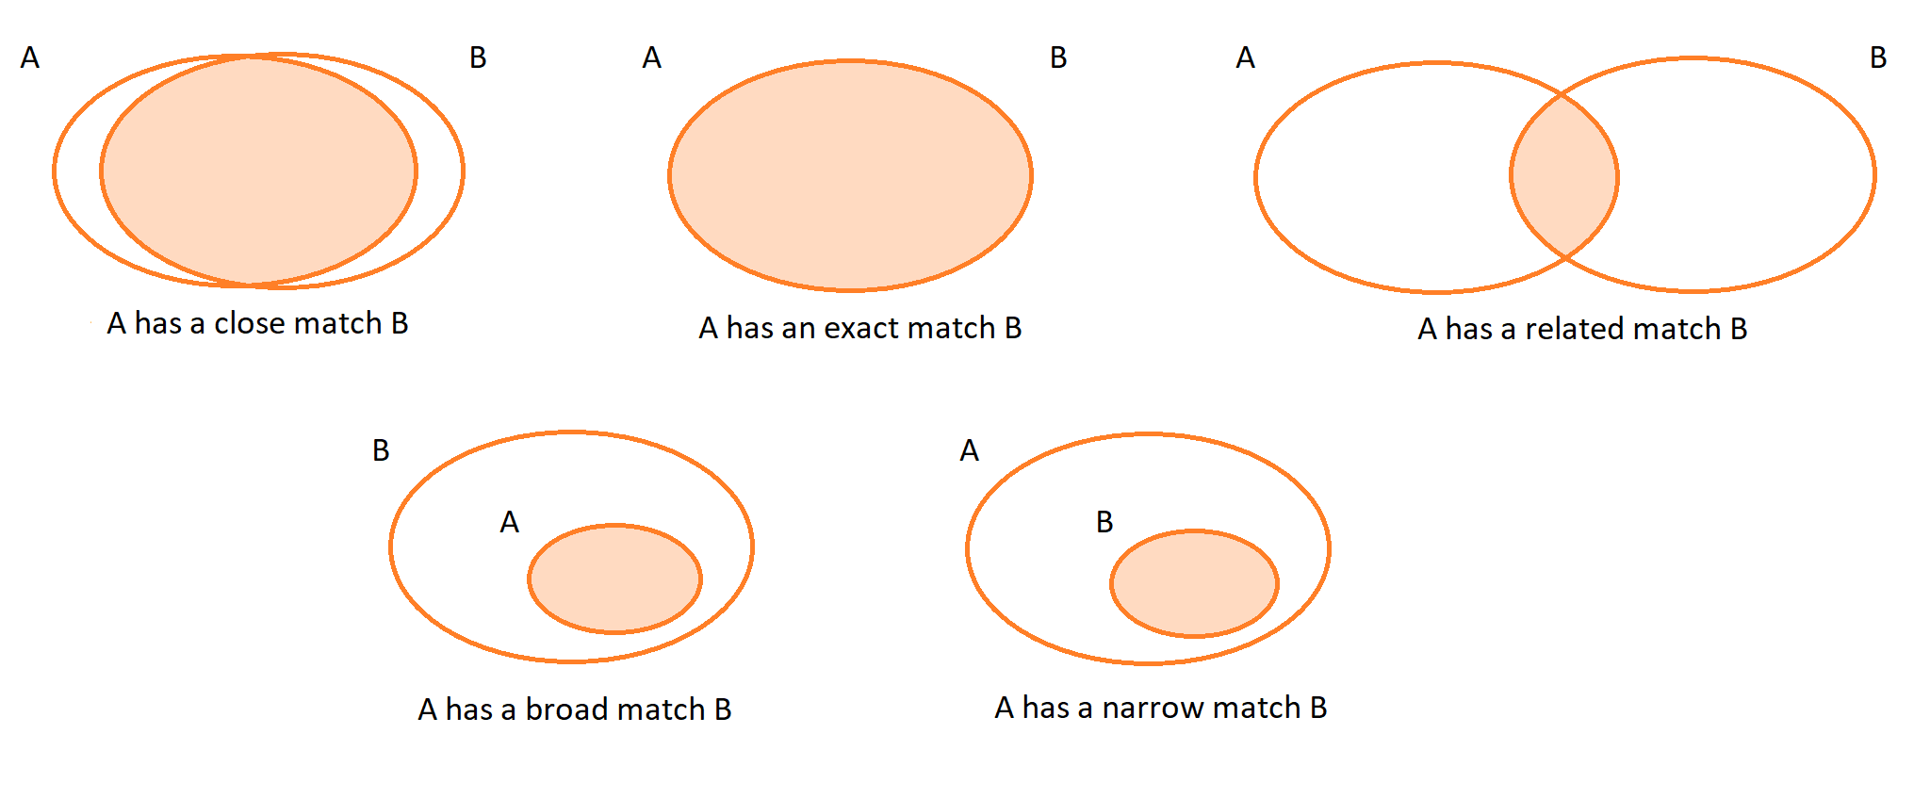
Step 1
Step 4: SKOS mapping
Step 2
Step 3
Step 4
Step 5
Step 6
source and more information via: https://bit.ly/userhandbookisa (p.22-23)

Slide 52
Step 1
Step 4: Map on existing voc’s and AP’s
Step 2
Step 3
Step 4
Exercise: Make a mapping with our concepts (see step 2) and relevant classes from existing vocabularies and application profiles.
Step 5
Step 6
Concept | Mapping | Class
Library | Exact - Close Match | OSLO-Organisatie::GeregistreerdeOrganisatie
Creative Work | ?? | ??
Author | Exact Match | OSLO-Persoon::Persoon
Publisher | Exact Match | OSLO-Organisatie::GeregistreerdeOrganisatie

Slide 53
1. Define use case
2. List and inventarize relevant concepts
3. Study and look for existing vocabularies and AP’s
4. Map your concepts on the existing vocabularies and AP’s
5. Find a solution for unmapped concepts
6. Establish an implementation model

Slide 54
Step 1
Step 5: Find a solution for unmapped concepts
Step 2
Step 3
Step 4
Step 5
Look at international standards and vocabularies.
tip: https://lov.linkeddata.es/
DC terms
schema.org
dbpedia.org
Legislation and other official documents at Flemish, Belgian and European level.
Models that are already in use by other public administrations in Flanders, Belgium or Europe. An example is the Europeana data models.
Step 6

Slide 55
Step 1
Step 5: Some guidelines
Step 2
Step 3
Step 4
Check whether there are already international data standards that define the necessary.
Only in last instance define something completely yourself.
For these new entities:
Check whether these are also relevant in a different context, for other parties, in the context of information exchange and whether an alignment process should be started around this.
For things that don’t seem to match completely:
See if your information model cannot be adjusted.
If not: OSLO and other data standards can be changed. Feel free to send a comment!
If alignment is not possible in one of these 2 ways, please rename it.
Step 5
Step 6

Slide 56
Step 1
Step 5: Find a solution for unmapped concepts
Step 2
Step 3
Step 4
Exercise: Find a solution for unmapped concepts by looking at international standards.
Step 5
Step 6
Concept | Mapping | Class
Library | Exact - Close Match | OSLO-Organisatie::GeregistreerdeOrganisatie
Creative Work | Related match | ??
Author | Exact Match | OSLO-Persoon::Persoon
Publisher | Exact Match | OSLO-Organisatie::GeregistreerdeOrganisatie

Slide 57
Step 1
Step 5: Find a solution for unmapped concepts
Step 2
Step 3
Step 4
Exercise: Find a solution for unmapped concepts by looking at international standards.
Step 5
Step 6
Concept | Mapping | Class
Library | Exact - Close Match | OSLO-Organisatie::GeregistreerdeOrganisatie
Creative Work | Related match | https://schema.org/CreativeWork
Author | Exact Match | OSLO-Persoon::Persoon
Publisher | Exact Match | OSLO-Organisatie::GeregistreerdeOrganisatie
solution

Slide 58
1. Define use case
2. List and inventarize relevant concepts
3. Study and look for existing vocabularies and AP’s
4. Map your concepts on the existing vocabularies and AP’s
5. Find a solution for unmapped concepts
6. Establish an implementation model

Slide 59
Step 1
Step 6: Establish an implementation model
Step 2
Step 3
Step 4
A few guidelines for establishing an implementation model:
Step 5
Start from the entities we have listed.
An entity= concepts/information elements that make up the information model
Add attributes to the model
An attribute= a property of a particular entity
Add relationships to the model:
A relationship= the relationships between the entities
Add cardinalities to the model.
Showing how many times a relationship can occur (see example next slide)
(Make definitions more concrete).
Step 6

Slide 60
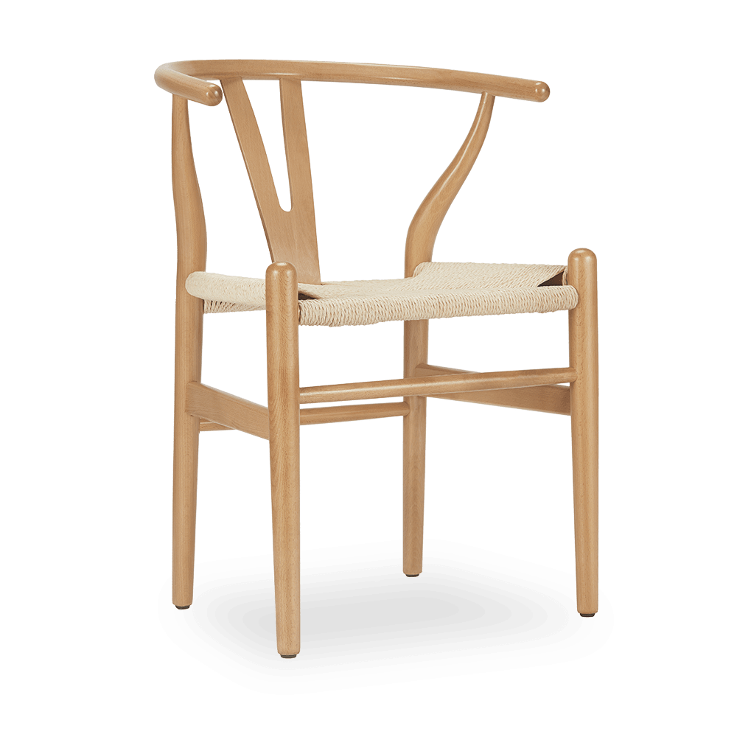
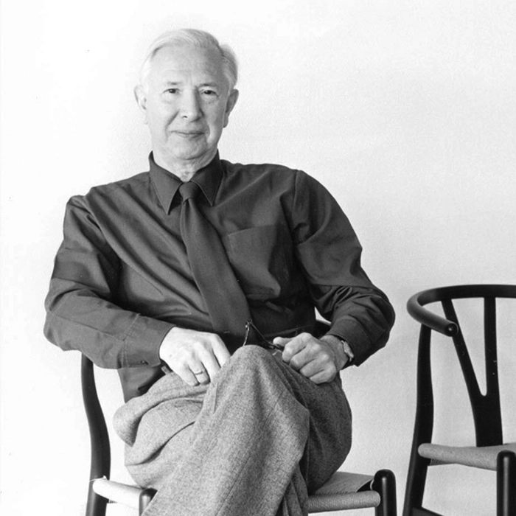
Step 1
Step 6: Establish an implementation model
Step 2
Step 3
Step 4
Cardinalities explained with an example:
Step 5
Step 6
has serial number
78034
1
1
has designer
0..*
1
is made of
<oak>
<papercord>
<Wishbone chair>
<Hans J. Wegner>
0..*
0..*
Notes:
The cardinalities says something on how many times a relationship can occur. There exist 3 types of relations:
1-to-1 relation: The Wishbone chair has only one unique serial number. And one serial number only belongs to one single chair.
1-to many-relation: The Wishbone chair has only one designer which is Hans Wegner. But Hans Wegner designed many (=*) other chairs.
Many-to-many relation: The Wishbone chair is made of multiple materials for example oak and papercord. But many things are made of the same materials.

Slide 61
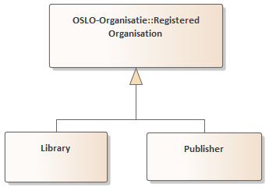
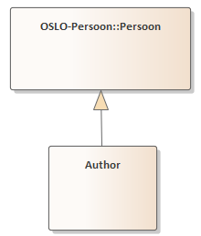
Step 1
Step 6: Establish an implementation model
Step 2
Step 3
Step 4
Start from the entities we have listed.
Step 5
Step 6
Concept
Library
Creative Work
Author
Publisher
https://data.vlaanderen.be/doc/applicatieprofiel/organisatie-basis/
solution
https://data.vlaanderen.be/doc/applicatieprofiel/persoon-basis/

Slide 62
Step 1
Step 6: Establish an implementation model
Step 2
Step 3
Step 4
Start from the entities we have listed.
Step 5
Step 6
Concept
Library
Creative Work
Author
Publisher
https://data.vlaanderen.be/doc/applicatieprofiel/organisatie-basis/
solution
https://data.vlaanderen.be/doc/applicatieprofiel/persoon-basis/

Slide 63
Step 1
Step 6: Establish an implementation model
Step 2
Step 3
Step 4
Start from the entities we have listed.
Step 5
Step 6
Concept
Library
Creative Work
Author
Publisher
https://schema.org/CreativeWork
https://data.vlaanderen.be/doc/applicatieprofiel/organisatie-basis/
solution
https://data.vlaanderen.be/doc/applicatieprofiel/persoon-basis/

Slide 64
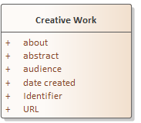
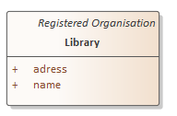
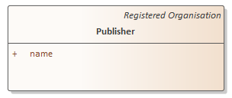
Step 1
Step 6: Establish an implementation model
Step 2
Step 3
Step 4
Add attributes to the model
Step 5
Step 6
https://schema.org/CreativeWork
https://data.vlaanderen.be/doc/applicatieprofiel/organisatie-basis/
solution
https://data.vlaanderen.be/doc/applicatieprofiel/persoon-basis/

Slide 65
Step 1
Step 6: Establish an implementation model
Step 2
Step 3
Step 4
Add relationships to the model:
Step 5
Step 6
solution

Slide 66
Step 1
Step 6: Establish an implementation model
Step 2
Step 3
Step 4
Add relationships to the model:
Step 5
Step 6
solution

Slide 67
Step 1
Step 6: Establish an implementation model
Step 2
Step 3
Step 4
Add relationships to the model:
Step 5
Step 6
solution

Slide 68
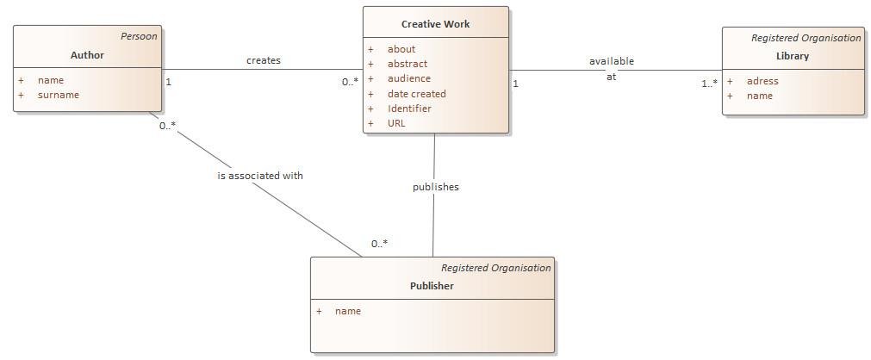
Step 1
Step 6: Establish an implementation model
Step 2
Step 3
Step 4
Add cardinalities to the model.
Step 5
Step 6
solution

Slide 69
Back to the plenary meeting
https://bit.ly/kbrworkshop

Slide 70
14:45 - 15:00 - Wrap-up
Any questions?
Feedback - Did we meet the expectations? Please give feedback in the chat.

Slide 71
Thank you!

